Slide 1
Real-time Deployment on Kubernetes cluster using jenkins CI/CD

Slide 2
Introduction to the Tools
Jenkins: Open-source automation server used to automate various stages of software development related to building, testing, and deploying applications.
GitHub: A web-based hosting service for version control using Git, where the source code is stored and versioned.
Docker: Platform to develop, ship, and run applications inside lightweight, portable containers, making deployments easier.
Kubernetes: A container orchestration platform for automating application deployment, scaling, and management in containerized environments.
Ansible: An open-source automation tool to automate IT infrastructure management, including deployment and configuration.

Slide 3
Setting Up Jenkins for CI/CD
Install Jenkins and configure the necessary plugins (Docker, GitHub, Kubernetes, Ansible).
Create and configure Jenkins jobs for Continuous Integration (CI) and Continuous Deployment (CD).
Set up webhook triggers for GitHub repositories to automatically initiate Jenkins pipelines upon changes (code commits).

Slide 4
Dockerizing the Application
Create a Dockerfile: Define the necessary environment for the application.
Build Docker Image: Use Jenkins to automatically build Docker images for each code commit.
Push Docker Image to Docker Registry: Configure Jenkins to push the Docker image to a private or public Docker registry (e.g., Docker Hub).

Slide 5
Setting Up Kubernetes Cluster
Set up a Kubernetes cluster using a managed service (like Google Kubernetes Engine, Amazon EKS, or self-hosted).
Configure the Kubernetes cluster with appropriate namespaces, deployments, services, and ingress rules.
Use Kubernetes' Helm charts for easier application deployment and management.

Slide 6
Automating Deployments Using Ansible
Use Ansible to automate the configuration and management of the Kubernetes cluster and deploy the application.
Write Ansible playbooks to deploy Docker images on Kubernetes pods, including managing environment variables, secrets, and configurations.

Slide 7
Integrating Jenkins with GitHub
Create a Jenkins pipeline (Declarative or Scripted) that:Pulls the latest code from GitHub.
Builds the Docker image.
Pushes the image to the registry.
Deploys the containerized app to the Kubernetes cluster.

Slide 8
Continuous Integration (CI) Pipeline
Continuous Deployment (CD) Pipeline
On successful build and testing, automatically deploy the new Docker container to the Kubernetes cluster.
Use rolling updates in Kubernetes for seamless deployments with zero downtime.
Rollback functionality in case of failed deployments.
Trigger pipeline execution on code commits/pushes to GitHub.
Run unit tests, integration tests, and static code analysis during the build process.
Ensure Docker images are built for different environments (dev, staging, production).

Slide 9
Monitoring and Notifications
Integrate Jenkins with notification systems (Slack, Email, etc.) to alert the team about build and deployment statuses.
Set up monitoring for your Kubernetes cluster (e.g., Prometheus, Grafana) to track application performance and availability.

Slide 10
Security Considerations
Ensure security best practices in Docker (e.g., using minimal base images, running containers as non-root users).
Secure access to Jenkins, Kubernetes, and Docker registries using authentication and authorization mechanisms (e.g., OAuth, Kubernetes RBAC, Docker Registry credentials).
Use tools like Helm Secrets or Kubernetes secrets to handle sensitive data.

Slide 11
Benefits of This Approach
Automation: Streamlined deployment process, reducing manual intervention.
Consistency: Ensure consistent environments across development, testing, and production.
Scalability: Leverage Kubernetes for auto-scaling and easy resource management.
Faster Delivery: Frequent, smaller updates with minimal downtime, improving the release cycle.
Collaboration: GitHub as a single source of truth for code and Jenkins automating the rest.

Slide 12
Conclusion
Benefits:
Automated CI/CD pipeline for consistent deployments.
Real-time application deployment with minimal downtime.
Seamless integration between Jenkins, Docker, GitHub, and Kubernetes.
Challenges:
Managing Kubernetes resources efficiently.
Debugging deployment issues and monitoring in real time.

Slide 13
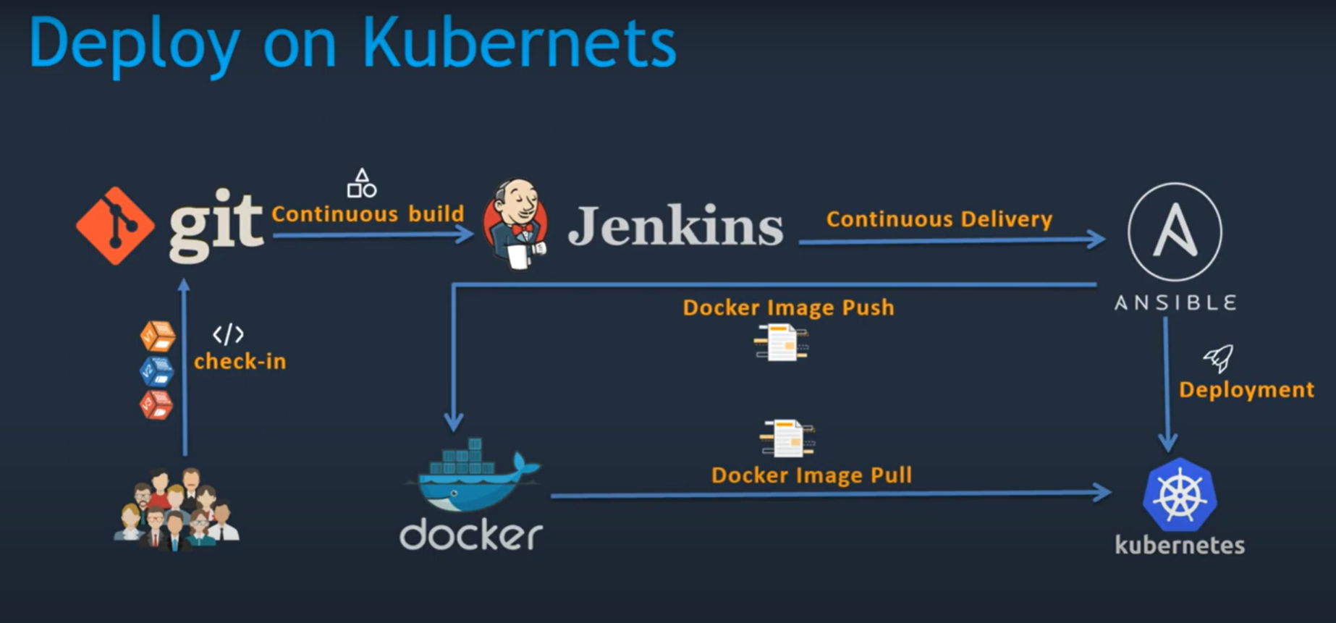
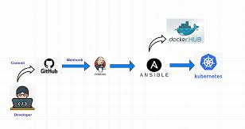

Slide 14
thank you

